Slide 1
SEGR 5240
Software Architecture and Design II

Slide 2
Design Patterns
Let’s talk about The Gang of Four

Slide 3
Buildings and software
When is building architecture like software architecture
We have 1000s of years of experience with buildings
We have decades with software systems
Everybody understands a building
Patterns are clearly visible in the building
Notes:
Somebody explain the golden ratio for me.
https://www.mathsisfun.com/numbers/golden-ratio.html

Slide 4
A Pattern Language
Christopher Alexander, et al
Late 1970s
http://en.wikipedia.org/wiki/A_Pattern_Language
http://en.wikipedia.org/wiki/The_Timeless_Way_of_Building
All about building buildings, not about software

Slide 5
Alexander’s definition
Each pattern describes a problem which occurs over and over again in our environment, and then describes the core of the solution to that problem, in such a way that you can use the solution a million times over, without ever doing it the same way twice.

Slide 6
What is a pattern
Describes a problem which occurs over and over again
Describes a solution to that problem
Can be applied millions of times, each time in a different way
…descriptions of communicating objects and classes that are customized to solve a general design problem in a particular context

Slide 7
The Gang of Four definition
A design pattern systematically names, motivates, and explains a general design that addresses a recurring design problem in object-oriented systems. It describes the problem, the solution, when to apply the solution, and its consequences. It also gives implementation hints and examples. The solution is a general arrangement of objects and classes that solve the problem. The solution is customized and implemented to solve the problem in a particular context.

Slide 8
TL;DR Our pattern language
The pattern name
The problem statement
The solution
The consequences
Notes:
Name – a handle that we can use to describe a design problem, its solutions, and consequences, in a word or two.
Problem statement – describes when to apply the problem. It explains the problem in its context.
Solution – describes the elements that make up the design, their relationships, responsibilities, and collaborations
Consequences are the results and trade-offs applying the pattern. These are critical to determine space and time trade-offs.

Slide 9
Or, in slightly more detail
Pattern name and classification
Intent
Also known as
Motivation
Applicability
Structure
Participants
Collaborations
Consequences
Implementation
Sample code
Known uses
Related patterns
Notes:
Name – conveys the essence of the pattern succinctly
Intent – answers the following questions: What does the design pattern do? What is its rationale and input? What particular design issue or problem does it address?
AKA – just that, other names
Motivation – A scenario that illustrates the design problem and how the objects and structures in the pattern solve the problem
Applicability – In which situations can the design pattern to applied? What are examples of poor designs that the pattern can address?
Structure – A graphical representation of the classes in the pattern using some well-known notation (OMT in GoF). May include interaction diagrams (Booch) to illustrate collaborations
Participants – The class and / or objects participating in the design pattern and their responsibilities
Collaborations – How the participants collaborate to carry out their responsibilities
Consequences – how does the pattern support its objectives? What are the trade-offs and results of using the pattern? What aspect of system structure does it let you vary independently?
Implementation – What pitfalls, hints, or techniques should you be aware of when implementing the pattern?
Sample code – code fragments, usually in C++ or Smalltalk (OO languages of the time)
Known uses – Examples of the pattern found in the wild. In GoF there are usually two examples per pattern.
Related patterns – What design patterns are closely related to this one? What are the important differences? With which other patterns should this one be used?

Slide 10
How design patterns solve design problems
Finding appropriate objects
Determining object granularity
Specifying object interfaces
Specifying object implementations

Slide 11
How patterns and framework relate
Design patterns are more abstract than frameworks
Design patterns are smaller architectural elements than frameworks
Design patterns are less specialized than frameworks
In short, patterns are patterns, frameworks are implementations
Notes:
But note that GoF talks about “frameworks” here to mean domain-specific frameworks, not general frameworks. So, graphical editor framework, spreadsheet framework, simulation framework are good examples. Generic libraries (.Net BCL, Java JDK, stdlib, boost) are useful for creating many classes of application. There are higher level frameworks that bridge that boundary. Think about windowing libraries, widget libraries, javascript frameworks.

Slide 12
Pattern types
Creational patterns concern the process of object creation
Structural patterns deal with the composition of classes or objects
Behavioral patterns characterize the ways in which classes or objects interact and distribute responsibility

Slide 13
Design pattern space
 |  | Purpose
 |  | Creational | Structural | Behavioral
Scope | Class | Factory Method (107) | Adapter (class) (139) | Interpreter (243) Template Method (325)
 | Object | Abstract Factory (87) Builder (97) Prototype (117) Singleton (127) | Adapter (object) (139) Bridge (151) Composite (163) Decorator (175) Façade (185) Flyweight (195) Proxy (207) | Chain of responsibility (223) Command (233) Iterator (257) Mediator (273) Memento (283) Observer (293) State (305) Strategy (315) Visitor (331)

Slide 14
The patterns – creational patterns
Design pattern | Description
Abstract factory (87) | groups object factories that have a common theme
Builder (97) | constructs complex objects by separating construction and representation
Factory method (107) | creates objects without specifying the exact class to create
Prototype (117) | creates objects by cloning an existing object
Singleton (127) | restricts object creation for a class to only one instance

Slide 15
The patterns – structural patterns
Design pattern | Description
Adapter (139) | allows classes with incompatible interfaces to work together by wrapping its own interface around that of an already existing class
Bridge (151) | decouples an abstraction from its implementation so that the two can vary independently
Composite (163) | composes zero-or-more similar objects so that they can be manipulated as one object
Decorator (175) | dynamically adds / overrides behavior in an existing method of an object.
Façade (185) | provides a simplified interface to a large body of code
Flyweight (195) | reduces the cost of creating and manipulating a large number of similar objects
Proxy (207) | provides a placeholder for another object to control access, reduce cost, and reduce complexity

Slide 16
The patterns – behavioral patterns
Design pattern | Description
Chain of responsibility (223) | delegates commands to a chain of processing objects
Command (233) | creates objects which encapsulate actions and parameters
Interpreter (243) | implements a specialized language
Iterator (257) | accesses the elements of an object sequentially without exposing its underlying representation
Mediator (273) | allows loose coupling between classes by being the only class that has detailed knowledge of their methods
Memento (283) | provides the ability to restore an object to its previous state (undo)
Observer (293) | is a publish / subscribe pattern which allows a number of observer objects to see an event
State (305) | allows an object to alter its behavior when its internal state changes
Strategy (315) | allows one of a family of algorithms to be selected on-the-fly at runtime
Template method (325) | defines the skeleton of an algorithm as an abstract class, allowing its subclasses to provide concrete behavior
Visitor (331) | separates an algorithm from an object structure by moving the hierarchy of methods into one object.

Slide 17
Design aspects that vary – creational patterns
Design pattern | Aspect(s) that can vary
Abstract factory (87) | Families of product objects
Builder (97) | How a composite object gets created
Factory method (107) | Subclass of object that is instantiated
Prototype (117) | Class of object that is instantiated
Singleton (127) | The sole instance of a class

Slide 18
Design aspects that vary – structural patterns
Design pattern | Aspect(s) that can vary
Adapter (139) | Interface to an object
Bridge (151) | Implementation of an object
Composite (163) | Structure and composition of an object
Decorator (175) | Responsibilities of an object without subclassing
Façade (185) | Interface to a subsystem
Flyweight (195) | Storage costs of objects
Proxy (207) | How an object is accessed; its location

Slide 19
Design aspects that vary – behavioral patterns
Design pattern | Aspect(s) that can vary
Chain of responsibility (223) | Object that can fulfill a request
Command (233) | When and how a request is fulfilled
Interpreter (243) | Grammar and interpretation of a language
Iterator (257) | How an aggregate’s elements are accessed; traversed
Mediator (273) | How and which objects interact with each other
Memento (283) | What private information is stored outside an object, and when
Observer (293) | Number of objects that depend on another object; how the objects stay up to date
State (305) | States of an object
Strategy (315) | An algorithm
Template method (325) | Steps of an algorithm
Visitor (331) | Operations that can be applied to object(s) without changing their class(es)

Slide 20
Common causes of redesign
Creating an object by specifying a class explicitly
Abstract Factory (87), Factory Method (107), Prototype (117)
Dependence on specific actions
Chain of Responsibility (223), Command (233)
Dependence on hardware and software platforms
Abstract Factory (87), Bridge (151)
Dependence on object representation or implementation
Abstract Factory (87), Bridge (151), Memento 9283), Proxy (207)

Slide 21
Common causes of redesign
Algorithmic dependencies
Builder (97), Iterator (257), Strategy (315), Template Method (325), Visitor (331)
Tight coupling
Abstract Factory (87), Bridge (151), Chain of Responsibility (223),
Command (233), Façade (185), Mediator (273), Observer (293)
Extending functionality by subclassing
Bridge (151), Chain of Responsibility (223), Composite (163),
Decorator (175), Observer (293), Strategy (315)
Inability to alter classes conveniently
Adapter (139), Decorator (175), Visitor (331)

Slide 22
How to select a design pattern
Consider how design patterns solve problems
Scan the Intent sections
Study how patterns interrelate
Study patterns of like purpose
Exam a cause of redesign
Consider what should be variable in your design

Slide 23
How to use a design pattern
Read the pattern once through for an overview
Go back and study the Structure, Participants, and Collaborations section
Look at the Sample Code section to see a concrete example
Choose names for pattern participants
Define the classes
Define application-specific names for operations
Implement the operations to carry out responsibilities and collaborations
Notes:
1 – pay attention to the application and consequences sections to ensure the pattern is right for your problem
2 – make sure you understand the classes and objects in the pattern and how they relate to one another
3 – studying the code helps you learn how to implement the pattern
4 – names for participants rarely appear in the application (remember, never implemented the same way twice), but it might make sense to introduce the name to make the linkage clear
5 – declare interfaces, establish inheritance hierarchies, and define the instance variables that represent data and object references
6 – Define the application- / implementation-specific names and naming conventions. For example, you might prefix “Create” on factory methods
7 – The implementation section offers hints and guidance; the sample code section may help as well

Slide 24
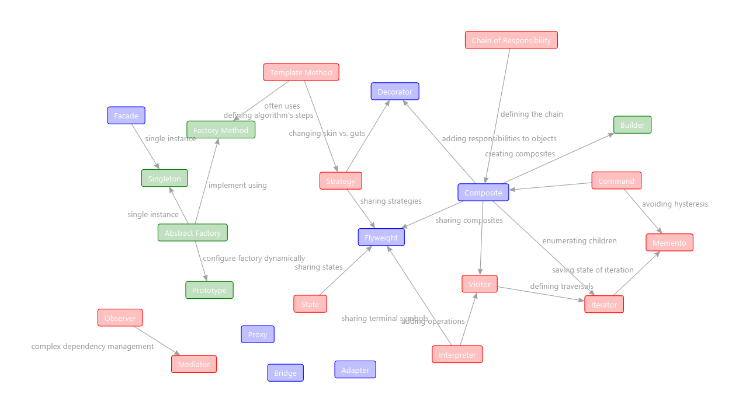
How they all relate

Slide 25
Criticisms
Failed to provide clear criteria for when to use what pattern
No economics
Focus on system software
Missed CRUD-based enterprise software
Can confuse patterns with domain objects – DON’T
Notes:
Jeff Atwood http://blog.codinghorror.com/rethinking-design-patterns/
1. Design patterns are a form of complexity. As with all complexity, I'd rather see developers focus on simpler solutions before going straight to a complex recipe of design patterns. 2. If you find yourself frequently writing a bunch of boilerplate design pattern code to deal with a "recurring design problem", that's not good engineering-- it's a sign that your language is fundamentally broken.
Steve Rowe https://blogs.msdn.microsoft.com/steverowe/2007/07/11/are-design-patterns-a-bad-idea/
Design patterns are very useful when we study how they work so we can create similar patterns. They are bad when we try to copy them directly. If one reads the Gang of Four, he will realize that the authors often give several examples of each pattern and they're all slightly different. One might also notice that there is a lot of talk about the OO concepts that lead to the patterns.
http://download.springer.com/static/pdf/650/chp%253A10.1007%252F3-540-52592-0_60.pdf?originUrl=http%3A%2F%2Flink.springer.com%2Fchapter%2F10.1007%2F3-540-52592-0_60&token2=exp=1461181181~acl=%2Fstatic%2Fpdf%2F650%2Fchp%25253A10.1007%25252F3-540-52592-0_60.pdf%3ForiginUrl%3Dhttp%253A%252F%252Flink.springer.com%252Fchapter%252F10.1007%252F3-540-52592-0_60*~hmac=0c68578d7701404f49ab6d81acdfd66fae026740e905e1eb980dc66984a2430e
http://www.cs.ubc.ca/labs/spl/papers/2002/oopsla02-patterns.pdf

Slide 26
What to expect from design patterns
A common design vocabulary
A documentation and learning aid
An adjunct to existing methods
A target for refactoring
Prototyping
Consolidation
More requirements
Expansion
More reuse

Slide 27
A parting thought
It is possible to make buildings by stringing together patterns, in a rather loose way. A building made like this, is an assembly of patterns. It is not dense. It is not profound. But it is also possible to put patterns together in such a way that many patterns overlap in the same physical space: the building is very dense; it has many meanings captured in a small space; and through this density, it becomes profound.
Christopher Alexander
A Pattern Language, page xli

Slide 28
For next week (and stuff)
Design Patterns on Wikipedia
http://en.wikipedia.org/wiki/Design_Patterns
http://en.wikipedia.org/wiki/Design_pattern
C# implementation
http://www.dofactory.com/Patterns/Patterns.aspx
Books (modeling and design)
http://www.amazon.com/Object-Oriented-Modeling-Design-James-Rumbaugh/dp/0136298419
http://www.amazon.com/Object-Life-Cycles-Modeling-States/dp/0136299407
http://www.amazon.com/Analysis-Patterns-Reusable-Object-Models/dp/0201895420
OOA & D
http://www.amazon.com/Object-Oriented-Analysis-Yourdon-Computing/dp/0136299814
http://www.amazon.com/Object-Oriented-Design-Peter-Coad/dp/0136300707
http://www.amazon.com/Object-Oriented-Programming-Peter-Coad/dp/013032616X
Other topics (networking)
http://www.amazon.com/Unix-Network-Programming-Volume-Networking/dp/0131411551
http://www.amazon.com/TCP-Illustrated-Volume-Addison-Wesley-Professional/dp/0321336313

